Slide 1
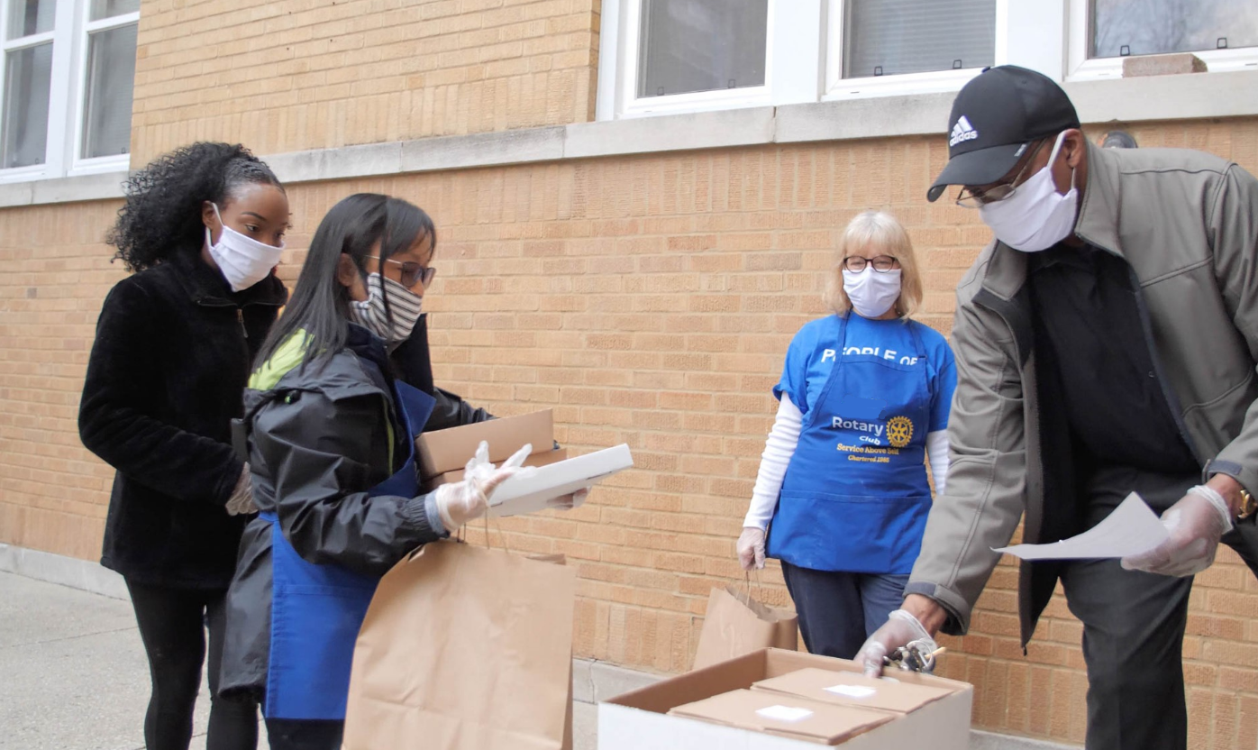
TOGETHER, WE
Respond
Notes:
Replace the photo with your own photo.
Update the VERB text (from ‘Respond’ to whatever you want it to be.)
Replace the Rotary logo with your own club’s logo.
SAVE this file as a JPG or PNG file (change the file type in the dropdown box when you save..)

